Slide 1
Library management using linked list
Team members
* E.madhuri(24kb1a05f1)
G.ananya(24kb1a05g5)
Ch.VishnuRachana(24kb1a05b7)
D.jaswika(24kb1a05e2)

Slide 2
Introduction:
The library management system is a c-based console application designed to manage books in a simple and efficient way.
It allows the user to add, delete, search, and display book records. each book has a unique id, a title, and an author name.
The records are stored dynamically in memory using a linked list.
This system operates using a singly linked list, a fundamental data structure that supports dynamic memory allocation.
Unlike static arrays, linked lists can expand and shrink at runtime, making them ideal for applications where the size of the dataset is not known in advance - like a library where books can be added or removed at any time.

Slide 3
Objective:
To Develop A Menu-driven System To Manage Library Books.
To Practice Dynamic Memory Allocation And Pointer-based Data Structures.
To Implement Common Operations Like Insertion, Deletion, Traversal, And Search.
To Gain Hands-on Experience In Structuring And Handling Real-world Data.

Slide 4
Why c and dsa:
.
C programming language:
C Is Close To System-level Programming, Making It Ideal For Learning Core Programming Concepts Like Memory Management And Data Structures.
It Provides Manual Memory Control Through Malloc() And Free() ,Essential For Understanding How Dynamic Data Structures Work.
The Language Is Light Weight And Fast ,Perfect For Simple Command-line Applications
Data structures & algorithms (dsa):
Singly Linked List:
Each node (struct Book) contains:
int id – Book ID
char title[100] – Book Title
char author[100] – Author Name
struct Book* next – Pointer to the next book

Slide 5
Algorithm:
Step-1:-
Start the Program
Initialize the head of the linked list to NULL.
Display a menu with options (Add, Delete, Search, Display, Exit).
Step-2:-
Add Book
Input book ID, title, and author.
Create a new node using malloc().
If the list is empty, set head = new node.
Else, traverse to the end and append the node.
Step-3:-
Delete Book
Input the book ID to delete.
Traverse the list to find the matching ID.

Slide 6
If found:
Adjust pointers to remove the node.
Free its memory.
If not found, display an error message.
Step-4:-
Search Book
Input the book ID to search.
Traverse the list.
If found, display book details.
Else, show "Book not found.”
Step-5:-
Display All Books
Traverse from the head node.
Print details of each book.
If list is empty, display a message.

Slide 7
Step-6:-
Exit Program
End The Loop.
(Optional) Free All Allocated Memory.
Terminate The Program.

Slide 8
Take away:
Demonstrated dynamic storage of book records using singly linked lists.
Learned how to allocate (malloc) and free memory, and the importance of avoiding memory leaks.
Functions were used to separate concerns (add, delete, search, display), improving
clarity and maintainability.
Used fgets() and strcspn() for reliable and safe string input from users.
This program serves as a base for building more advanced systems like file-based or
database-driven library apps.

Slide 9
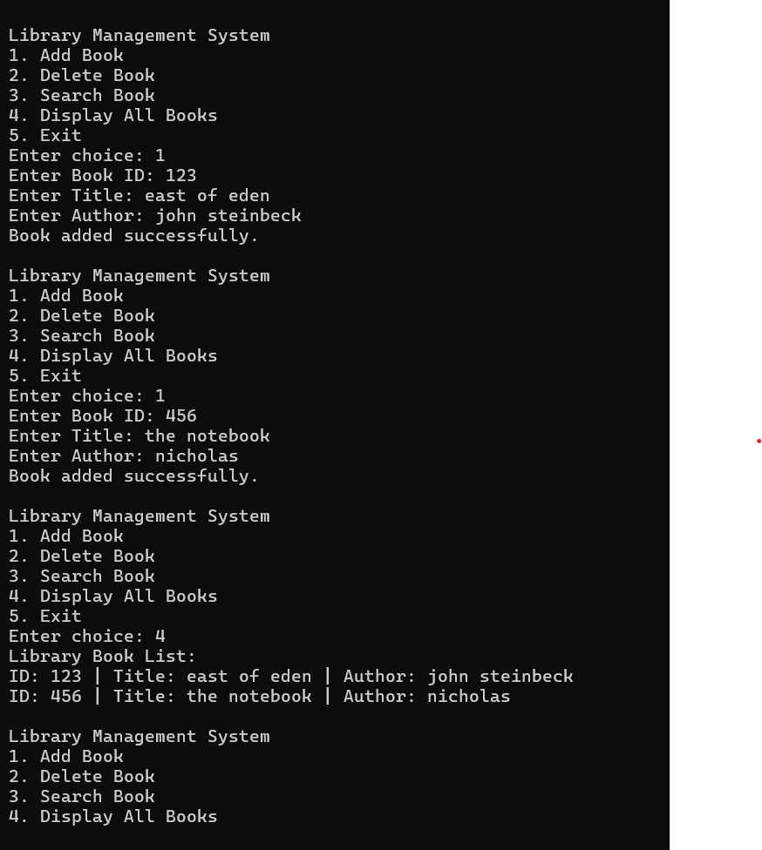
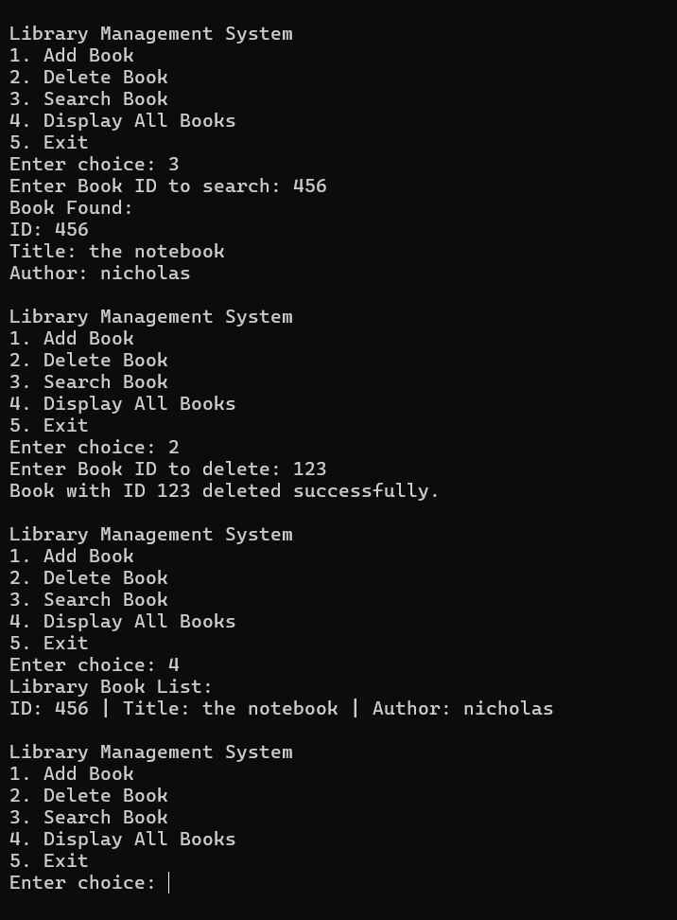
Output images:

Slide 10
Sample output:
Library Management System
1. Add Book
2. Delete Book
3. Search Book
4. Display All Books
5. Exit
Enter choice: 1
Enter Book ID: 101
Enter Title: The C Programming Language
Enter Author: Brian Kernighan
Book added successfully.
Enter choice: 4
Library Book List:
ID: 101 | Title: The C Programming Language | Author: Brian Kernighan
ID: 102 | Title: Clean Code | Author: Robert C. Martin
1. Add Book
2. Delete Book
3. Search Book
4. Display All Books
5. Exit
Enter choice: 3
Enter Book ID to search: 102
Book Found:
ID: 102
Title: Clean Code
Author: Robert C. Martin
Library Management System
Enter choice: 2
Enter Book ID to delete: 101
Book with ID 101 deleted successfully.

Slide 11
Conclusion:
simple yet effective implementation of a Library Management System using a singly linked list.
It efficiently handles core operations such as adding, deleting, searching, and displaying book records, each identified by a unique ID.
The program effectively demonstrates key programming concepts such as dynamic memory management, pointer manipulation, and linked list traversal.

Slide 12


